Slide 1
Benchmarking Lightweight Cryptography: Ascon, TinyJAMBU, and Xoodyak on MicroBlaze
Michael Rosales
Logan Zimmerman
Aidan Ancheta

Slide 2
Motivation
Lightweight Crypto
Demand in IoT & Embedded devices
Interested in comparing NIST finalists
MicroBlaze
Availability & Practical Relevance
Embedded Systems
Customizable

Slide 3
Overview
This project focused on benchmarking the software implementations of three Lightweight Cryptography (LWC) algorithms—Ascon, TinyJambu, and Xoodyak—on the MicroBlaze softcore processor

Slide 4
Lightweight Crypto
Algorithm | State Size | Versatility | Speed | Security Strength | Typical Use Cases
Ascon | 320 bits | Supports: AEAD, Hashing | Fast on hardware, medium on software | Strong resistance to common attacks (collision, preimage) | IoT, Embedded devices, low-power environments
Xoodyak | 384 bits | Supports: AEAD, Hashing | Fast on hardware, optimized for both software and hardware | High security, resistant to attacks like differential and linear cryptanalysis | IoT, Embedded systems, cryptographic protocols
TinyJambu | 128 bits | Supports: AEAD only | Optimized for ultra-low resource devices | Efficient security with small key and state sizes | Constrained environments, ultra-low-power devices

Slide 5
Anticipated/Expected Results
LWC Benchmark on ATSAMD21G18 microcontroller(semi comparable)
32 bit ARM Cortex-M0+
48 MHz Clock
submission | variant | implementation | config | enc(0:0) | dec(0:0) | enc(0:64) | dec(0:64) | enc(512:0) | dec(512:0) | enc(1024:0) | dec(1024:0)
ascon | ascon128av12 | opt32 | os | 7.812 | 7.868 | 18.255 | 18.19 | 100.258 | 100.312 | 190.018 | 190.072
tinyjambu | tinyjambu128v2 | ref | os | 9.457 | 9.513 | 42.177 | 42.487 | 175.09 | 175.139 | 340.722 | 340.771
xoodyak | xoodyakround3 | XKCP-plain-ua | os | 14.58 | 14.833 | 22.236 | 21.914 | 50.911 | 51.159 | 90.175 | 90.423
Results in ms
Ascon is the fastest for smaller input sizes
TinyJambu is slightly slower than Ascon for smaller inputs but slowest for larger inputs
Xoodyak is slowest for smaller inputs, but outperforms both for larger input sizes (512 and 1024 bytes)
From: https://github.com/usnistgov/Lightweight-Cryptography-Benchmarking/tree/main

Slide 6
Setup
Create Microblaze with necessary IP’s and configurations in Vivado
Export Hardware to Vitis
Create applications and configure/optimize
Test and record data

Slide 7
System (Hardware)
MicroBlaze
32 bit, Optimization: PERFORMANCE, 100 MHz
UART
For user interface and communication
BRAM
Initial testing with smaller inputs
DDR2 SRAM
For bigger code sizes and for handling larger inputs, 200 MHz
AXI TIMER
To track the cycles of MicroBlaze

Slide 8
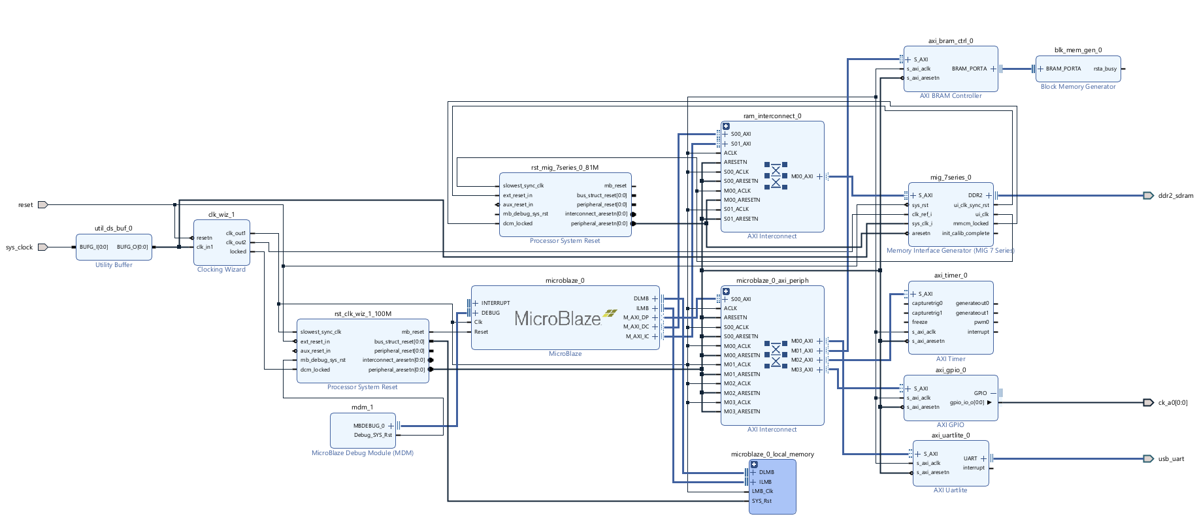
Block Design

Slide 9
System (Software)
Implementations sourced from official repositories (128 aead)
ASCON: opt32 implementation https://github.com/ascon/ascon-c/tree/main
TinyJAMBU: c32 implementation https://github.com/rweather/TinyJAMBU
XOODYAK: generic32 implementation https://github.com/XKCP/XKCP
Benchmarks Metrics:
Encryption time
Decryption time
Throughput
“Estimated” Power Consumption (Dynamic Power of FPGA * execution time)/1000

Slide 10
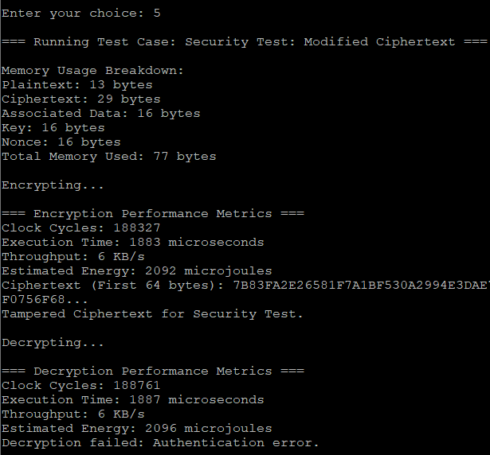
Testing Methodology
Each Algorithm was tested with no optimization and with -os optimization
Functional Test
Pt: ”Hello, world!”, 128 bit key, nonce and associated data
Edge Case
Pt:””, rest is same as previous
Performance (1KB)
Pt: 1024 ‘A’s, rest is same as previous
Performance (1MB)
Pt: 1024*1024 ‘A’s, rest is same as previous
Tampering Attack
Pt: “Security Test”, then first byte of ciphertext is changed after encrypted

Slide 11
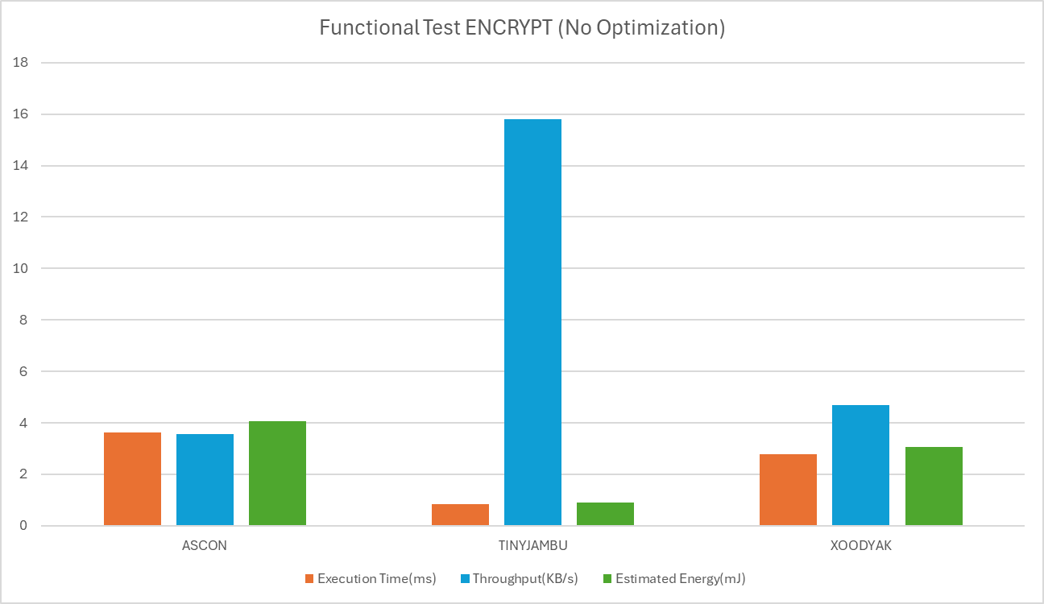
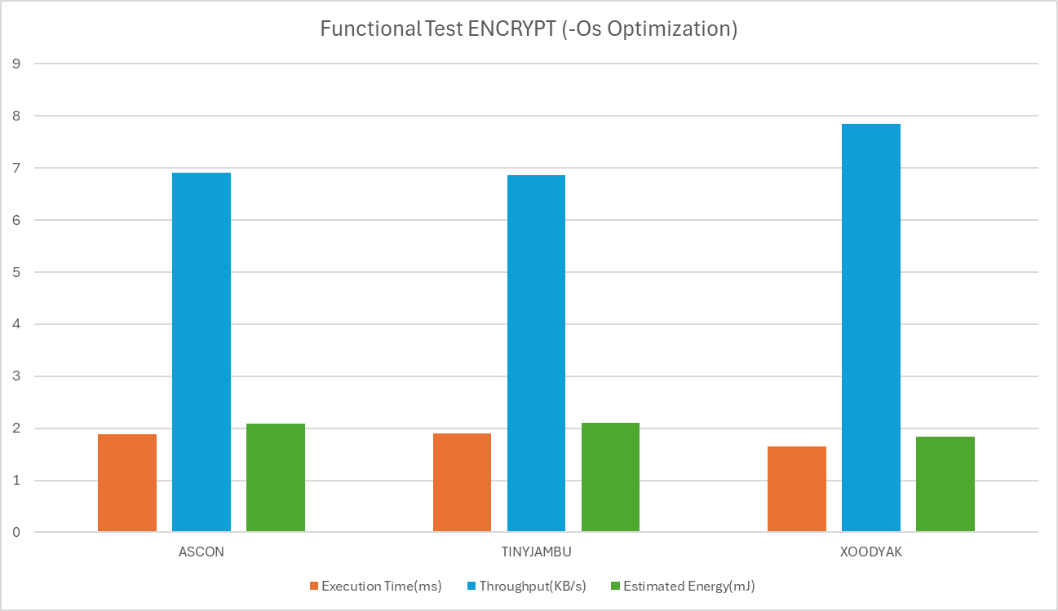
Findings (Functional + Encrypt)

Slide 12


Findings (Functional + Decrypt)

Slide 13
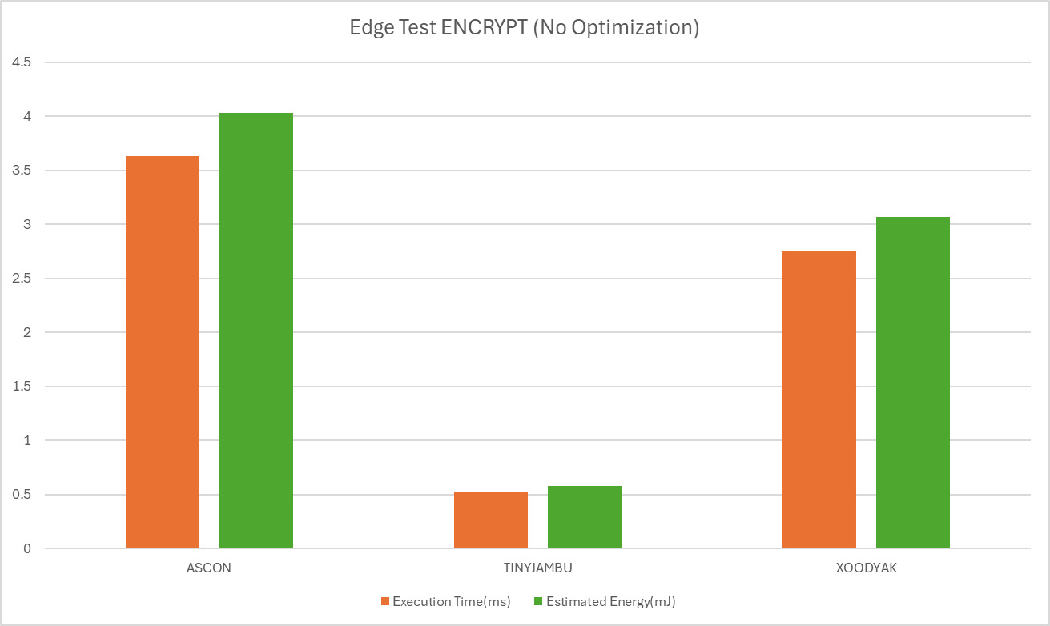
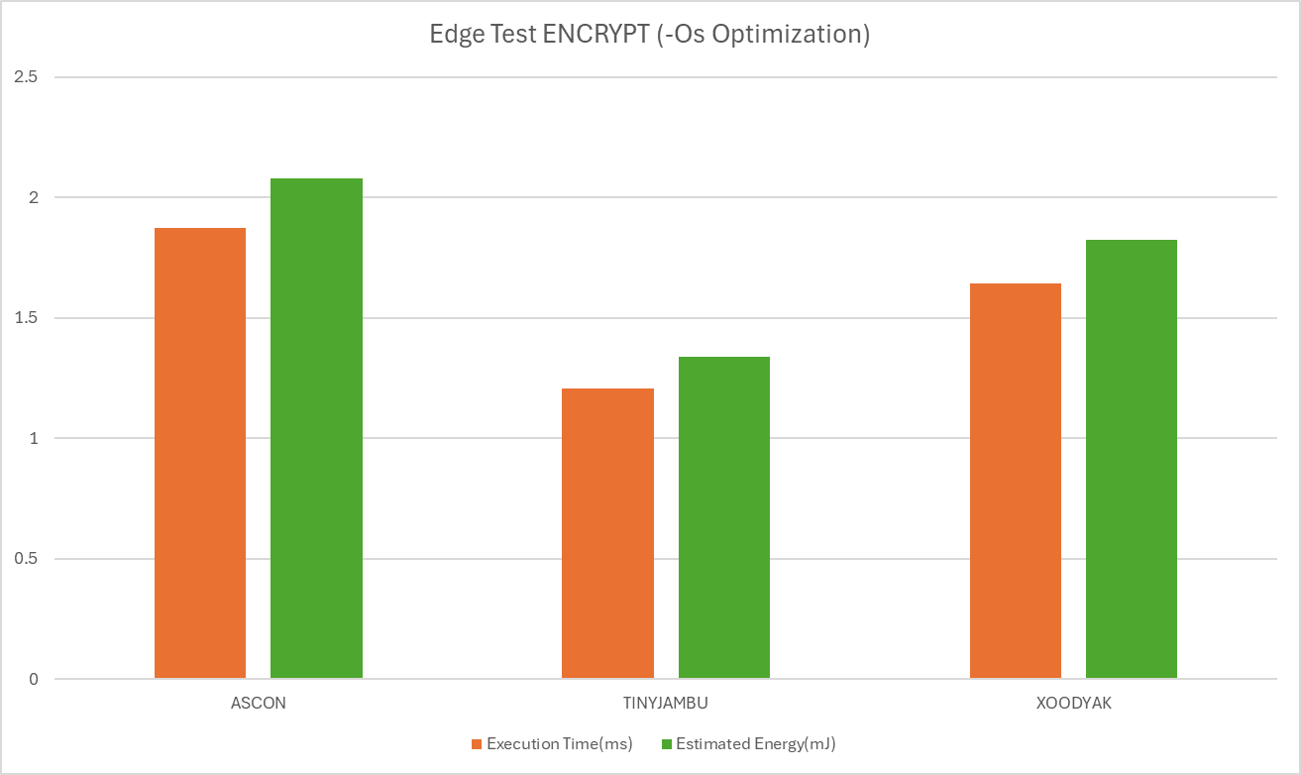
Findings (Edge Test + Encrypt)

Slide 14


Findings (Edge Test + Decrypt)

Slide 15
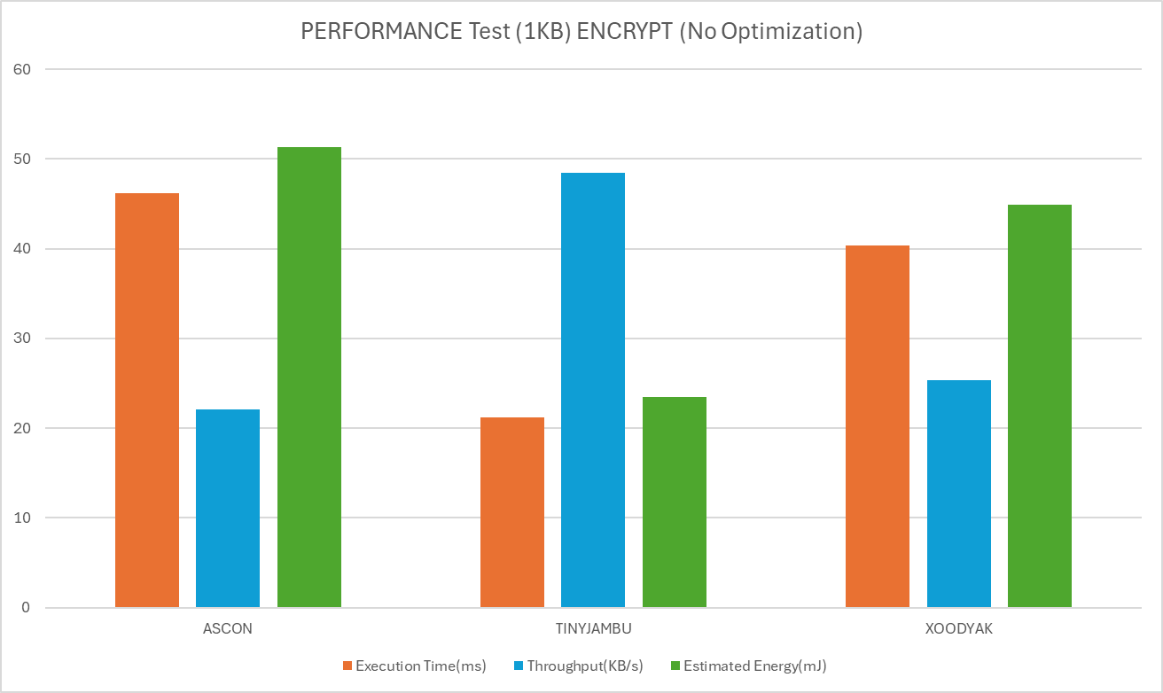
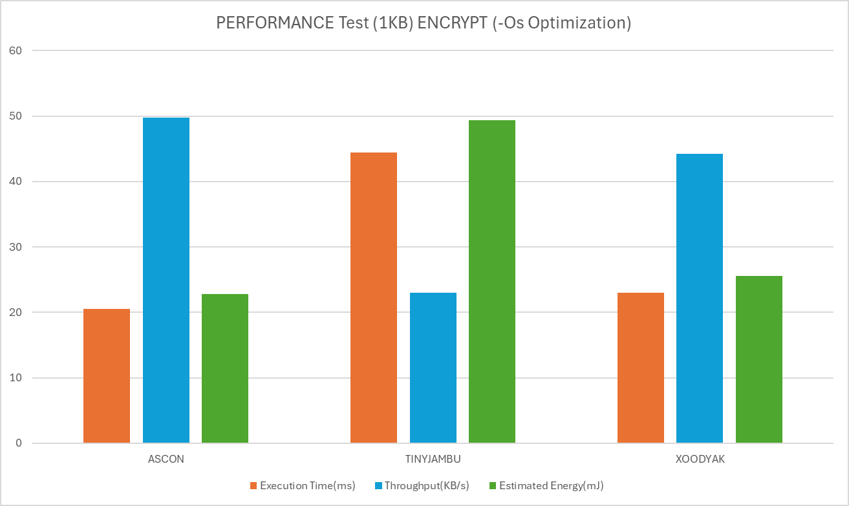
Findings (Performance Test, 1KB + Encrypt)

Slide 16
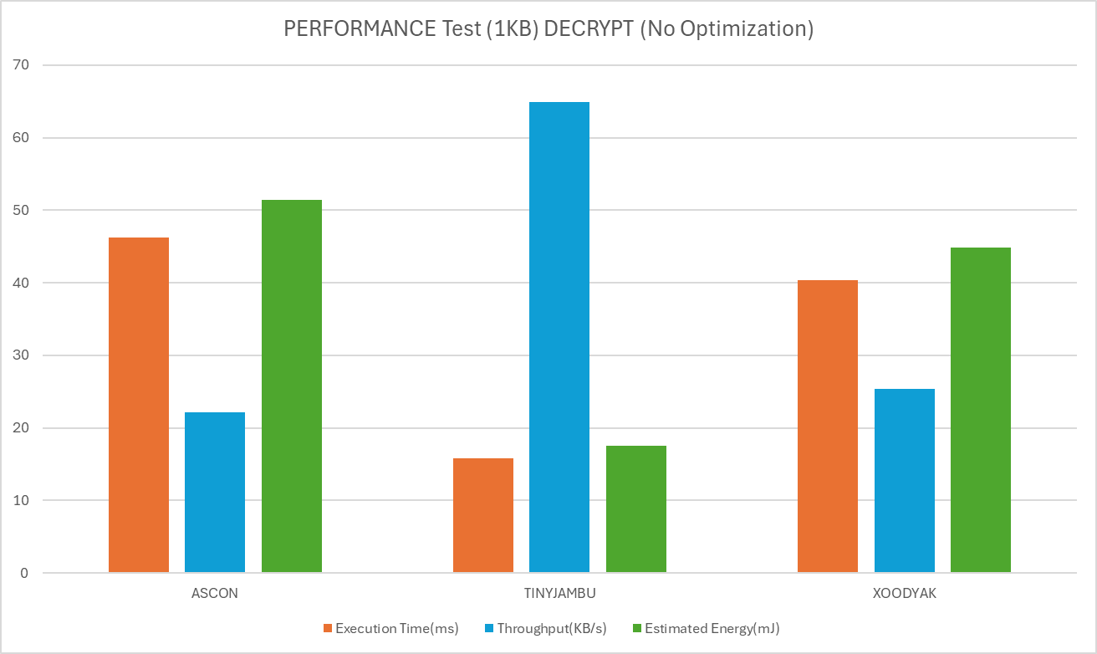

Findings (Performance Test, 1KB + Decrypt)

Slide 17
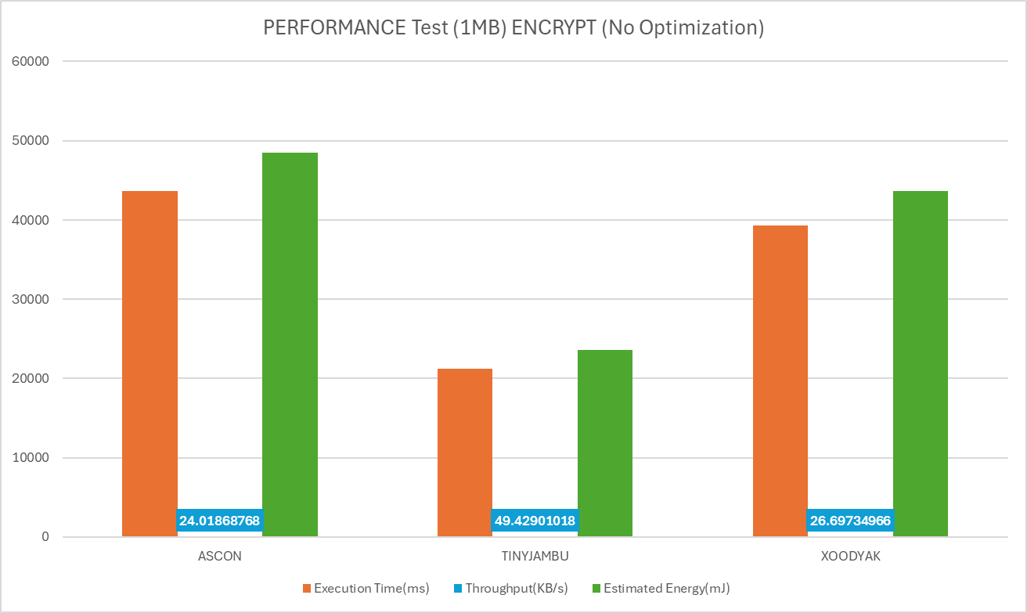
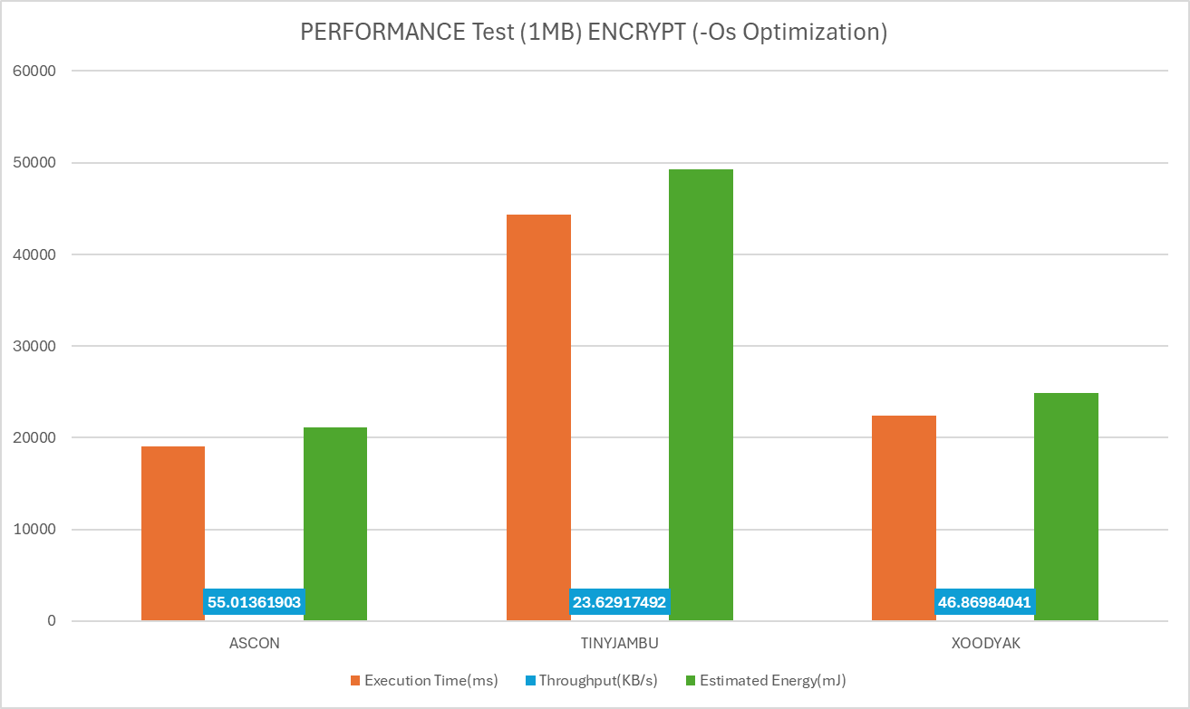
Findings (Performance Test, 1MB + Encrypt)

Slide 18
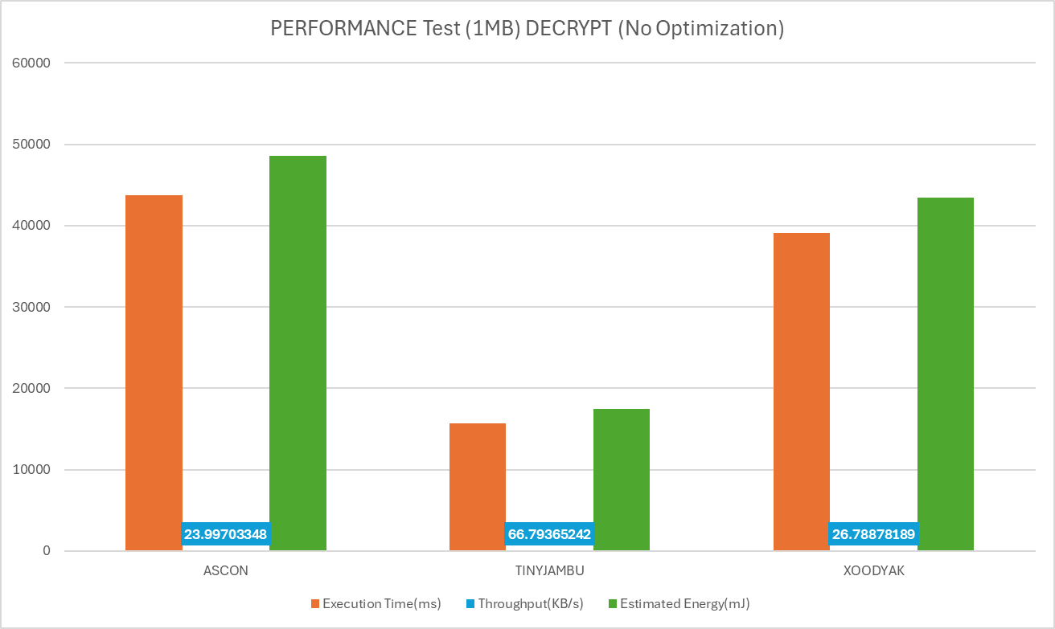
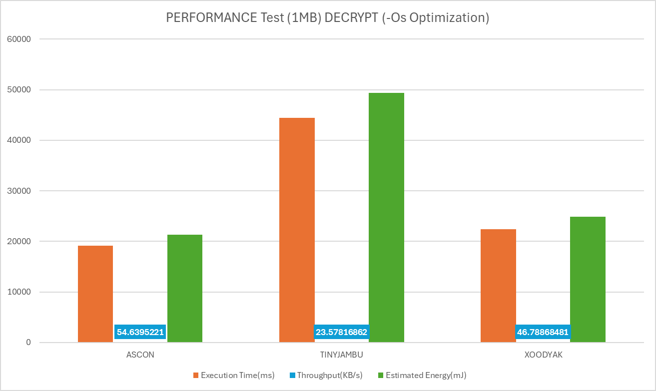
Findings (Performance Test, 1MB + Decrypt)

Slide 19
Summary of Experimental Results
When unoptimized:
Ascon: Slowest of the three and consistent Decryption times
TinyJambu: Fastest of the three(up to 85%) and larger inputs(1MB) Decryption time ~25% faster
Xoodyak: 2nd fastest, ~10% faster than Ascon and consistent Decryption times
When optimized(-os):
Ascon: Not fastest for smaller inputs, but fastest for larger inputs
Up to 56% faster
TinyJAMBU: Slowest of the three and consistent Decryption times
Up to 131% slower
Xoodyak: Fastest for smaller inputs, ~14% slower than Ascon for larger inputs
Up to 43% faster

Slide 20
Errors/Bugs
Errors implementing Microblaze hardware from Vivado to Vitis
XSA files at times were not compatible for Vitis use
As aforementioned, TinyJambu underperformed when optimized(-os) in Vitis
Attempted to use ILA IP for power consumption

Slide 21
Ways to Improve the Project
Increase testing parameters
Benchmark other Lightweight Cryptographics
Increase Datasets (inputs)
Test other optimizations (-o1, -o2,- o3)
Test the other lwc implementations
Including other benchmark metrics
Create different nonces/ADs
Optimize algorithms for microblaze
Including Accurate power consumption

